Slide 1

SQL PROJECT: E-COMMERCE ANALYSIS
BY OLOMOWEWE FATHIA OMOWUNMI
IT/SIWES Intern, HiiT Plc
DATA ANALYSIS course

Slide 2
THIS POWERPOINT FILE CONTAINS A SERIES OF QUERIES I CREATED TO ANALYZE E-COMMERCE DATA, ALONG WITH THE RESULTS GENERATED FROM EACH QUERY. THE QUERIES COVERED IN THIS MINI PROJECT ARE RANGE OF SQL I HAVE LEARNT IN CLASS INCLUDING ADVANCED QUERIES.

Slide 3

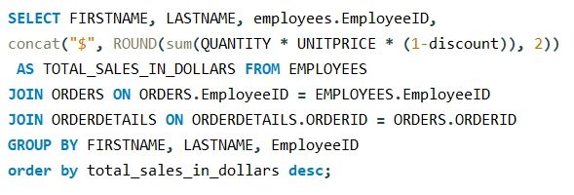
THIS IS a query tHAT calculateS the total sales (in dollars) made by each employee considering the quantity and unit price of products sold. IT SHOWS THE EMPLOYEES FIRST AND LAST NAME, EMPLOYEE ID AND THE TOTAL SALES THEY Made Rounded to 2 decimal places
Q1
THE QUERY
THE RESULT
FIRSTNAME | LASTNAME | EmployeeID | TOTAL_SALES_IN_DOLLARS
Margaret | Peacock | 4 | $9165
Nancy | Davolio | 1 | $4932.13
Janet | Leverling | 3 | $4675.58
Andrew | Fuller | 2 | $3489.09
Laura | Callahan | 8 | $3448.23
Michael | Suyama | 6 | $2902.49
Steven | Buchanan | 5 | $2177.74
Anne | Dodsworth | 9 | $2017.97
Robert | King | 7 | $1966.56

Slide 4
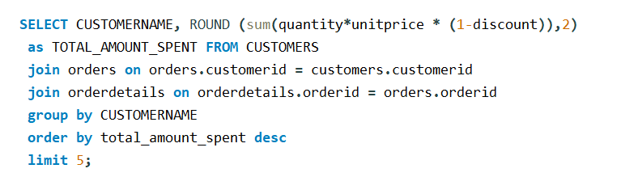
THIS IS a query tHAT SHOWS the top 5 customers who have generated the most revenue. IT Shows the customer’s name and the total amount they Have spent Rounded to 2 decimal places.
Q2
THE QUERY
THE RESULT
CUSTOMER_NAME | TOTAL_AMOUNT_SPENT
Ernst Handel | 3476.62
QUICK-Stop | 2095.85
Save-a-lot Markets | 1881.04
Frankenversand | 1846.87
Hungry Owl All-Night Grocers | 1665.99

Slide 5
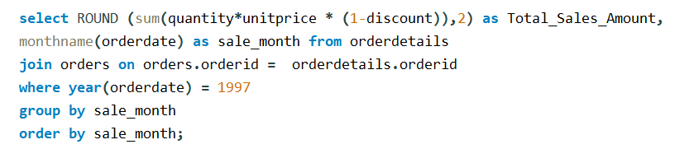
THIS IS A query tHAT displayS the total sales amount for each month in the year 1997 Rounded to 2 decimal places
Q3
THE QUERY
THE RESULT
Total_Sales_Amount | Sale_Month
2007.64 | February
5925.2 | January

Slide 6
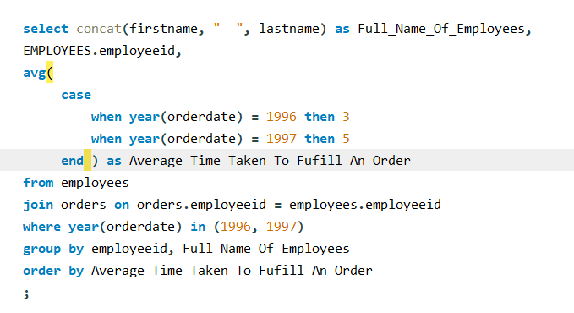
THIS IS A QUERY THAT SHOWS the average time (in days) taken to fulfil an order for each employee. Assuming shipping takes 3 or 5 days respectively depending on if the item was ordered in 1996 or 1997.
Q4
THE QUERY
THE RESULT
Full_Name_Of_Employees | employeeid | Average_Time_Taken_To_Fufill_An_Order
Steven Buchanan | 5 | 3.0000
Nancy Davolio | 1 | 3.2069
Michael Suyama | 6 | 3.3333
Anne Dodsworth | 9 | 3.3333
Andrew Fuller | 2 | 3.4000
Robert King | 7 | 3.4286
Margaret Peacock | 4 | 3.4500
Laura Callahan | 8 | 3.5926
Janet Leverling | 3 | 3.8387

Slide 7
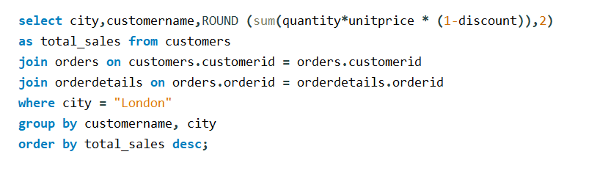
THIS IS A QUERY THAT ListS the customers operating in London and THE total sales for each OF THEM Rounded to 2 decimal places
Q5
THE QUERY
THE RESULT
city | customername | Total_sales
London | Seven Seas Imports | 1010.62
London | Eastern Connection | 355.18
London | Around the Horn | 235.97
London | Consolidated Holdings | 101.62
London | B''s Beverages | 70.86

Slide 8
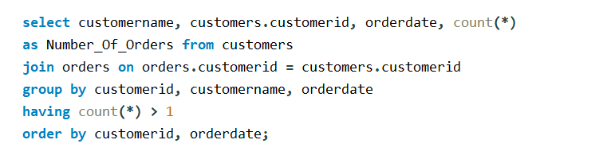
THIS IS A QUERY THAt shows customers who have placed more than one order on the same date.
Q6
THE QUERY
THE RESULT
customername | customerid | orderdate | Number_of_orders
Bottom-Dollar Marketse | 10 | 1997-01-10 00:00:00 | 2

Slide 9
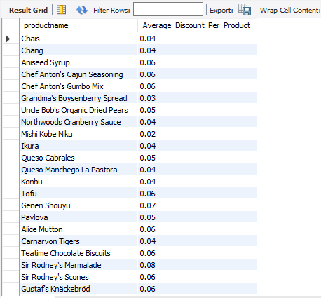
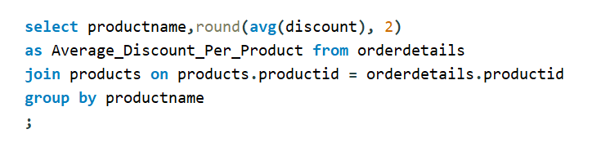
THIs is a query that Calculates the average discount given per product across all orders Rounded to 2 decimal places.
Q7
FIRST PORTION OF RESULT
THE QUERY

Slide 10
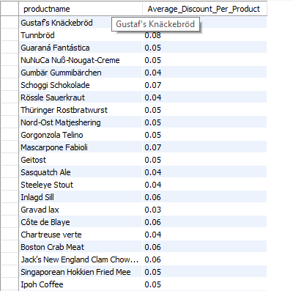
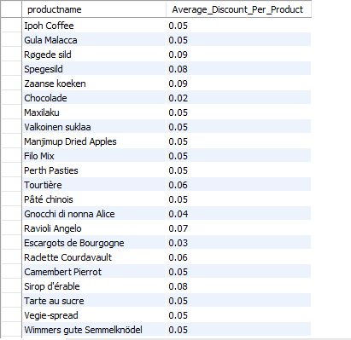
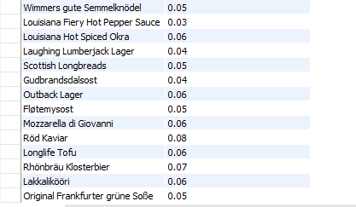
SECOND PORTION OF RESULT
THIRD PORTION OF RESULT
LAST PORTION OF RESULT

Slide 11
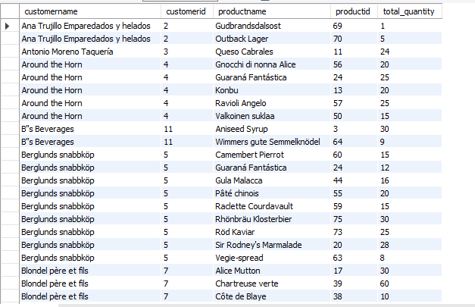
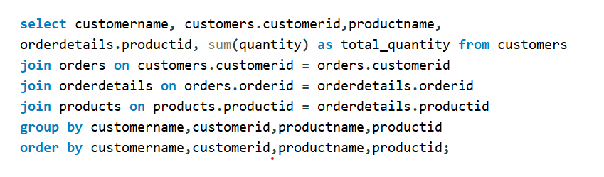
THIs is a query that For SHOWS each customer AND list the products they have ordered along with the total quantity of each product ordered.
Q8
FIRST PORTION OF RESULT
THE QUERY

Slide 12
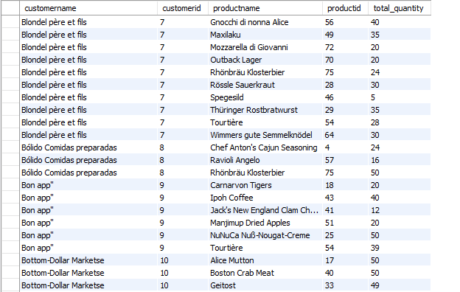
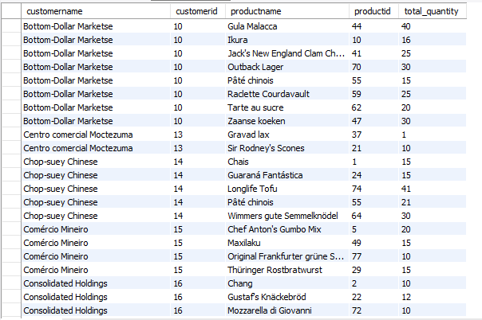
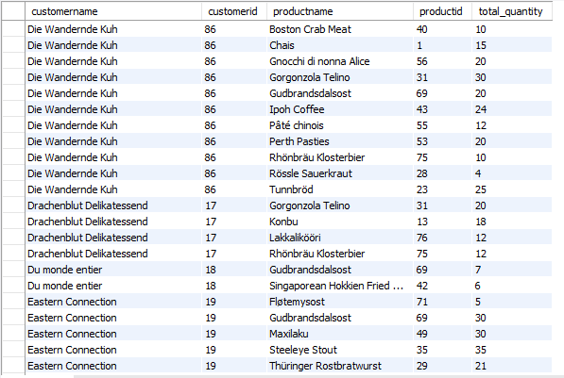
SECOND PORTION OF RESULT
THIRD PORTION OF RESULT
FOURTH PORTION OF RESULT

Slide 13
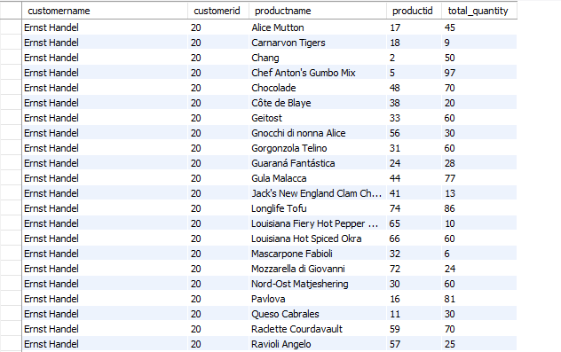
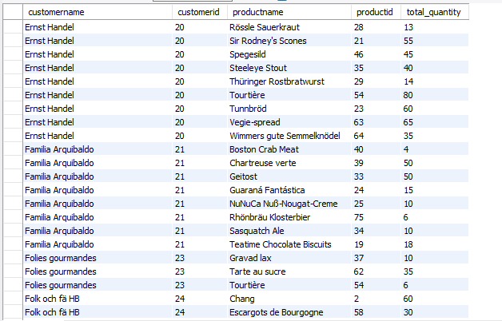
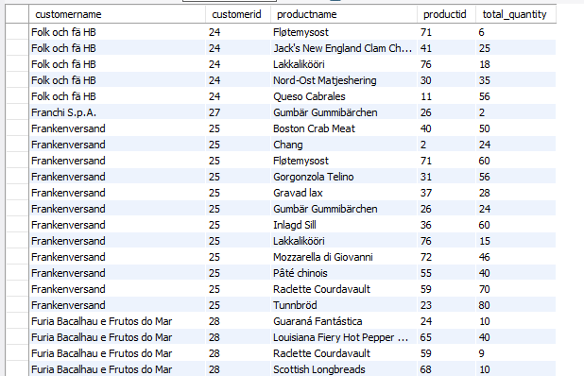
FIFTH PORTION OF RESULT
SIXTH PORTION OF RESULT
SEVENTH PORTION OF RESULT

Slide 14
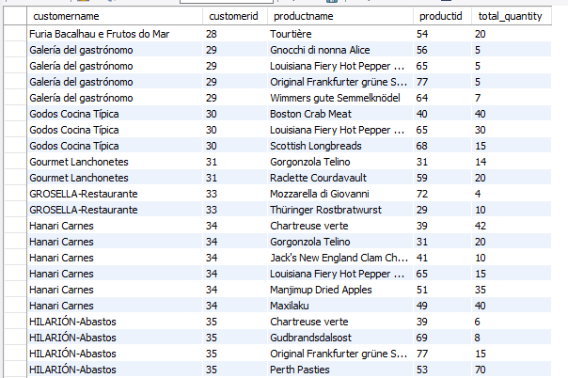
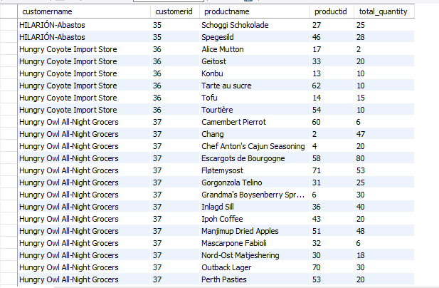
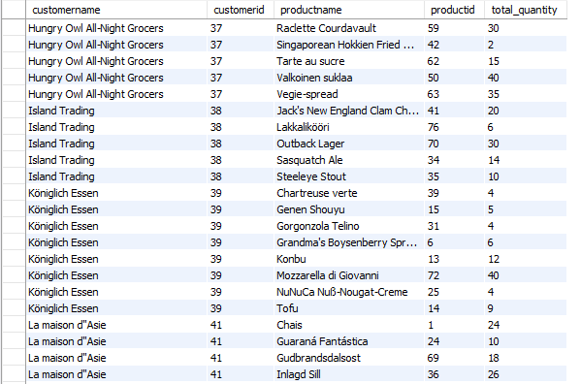
EIGHTH PORTION OF RESULT
NINTH PORTION OF RESULT
TENTH PORTION OF RESULT

Slide 15
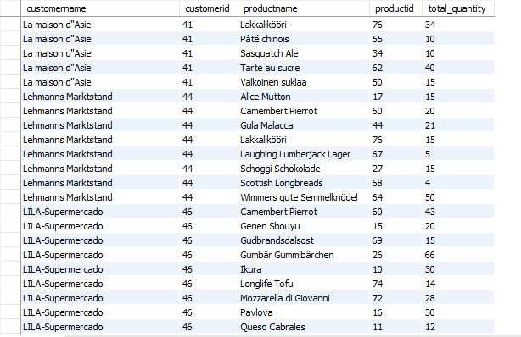
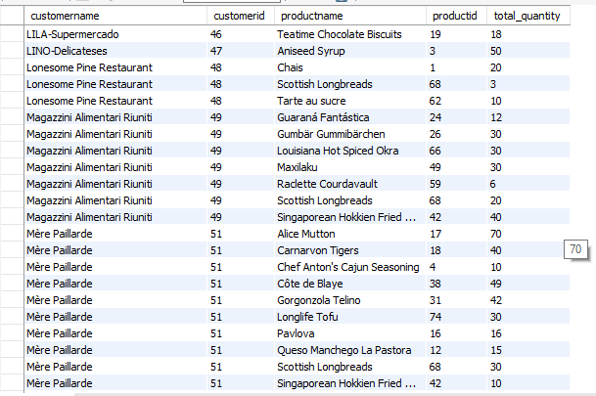
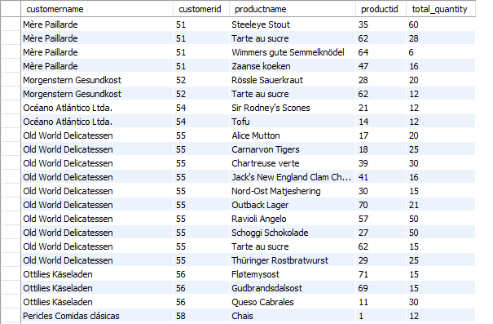
ELEVENTH PORTION OF RESULT
TWELFTH PORTION OF RESULT
THIRTEENTH PORTION OF RESULT

Slide 16
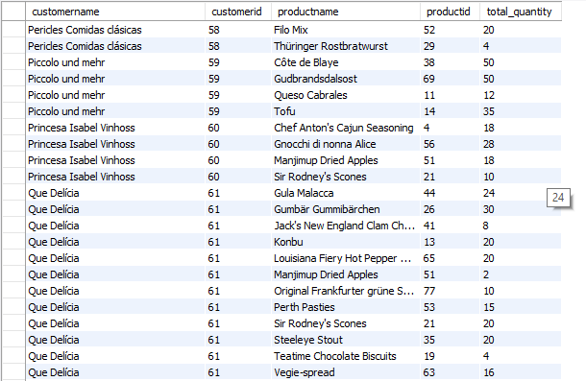
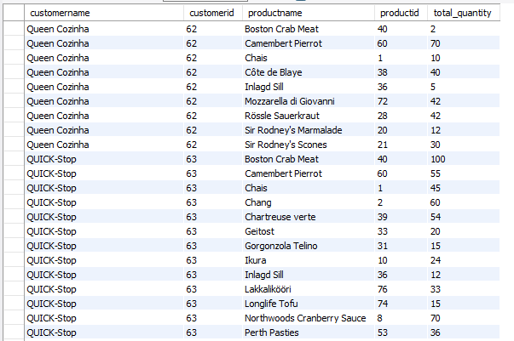
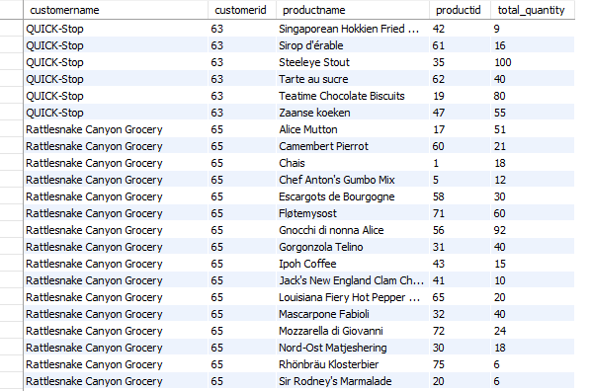
FOURTEENTH PORTION OF RESULT
FIFTEENTH PORTION OF RESULT
SIXTEENTH PORTION OF RESULT

Slide 17
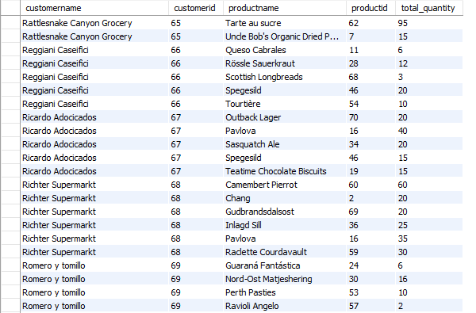
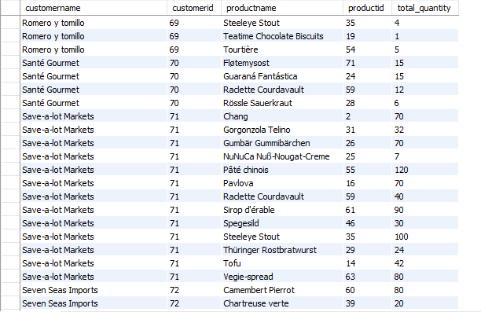
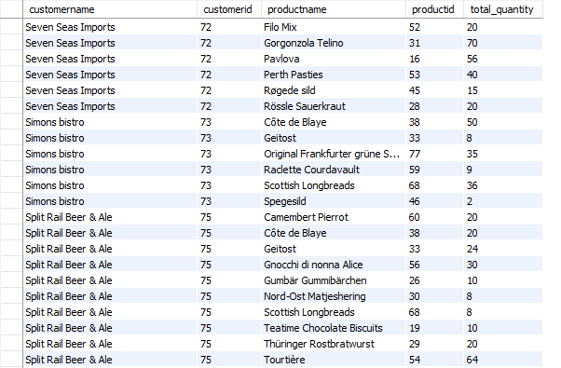
SEVENTEENTH PORTION OF RESULT
EIGHTEENTH PORTION OF RESULT
NINETEENTH PORTION OF RESULT

Slide 18
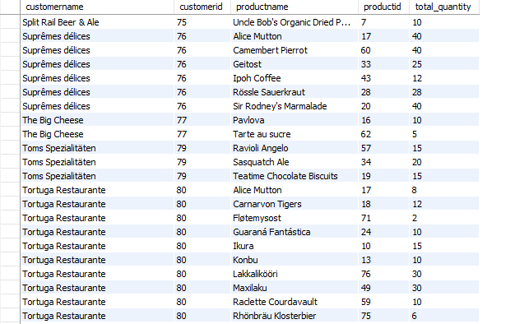
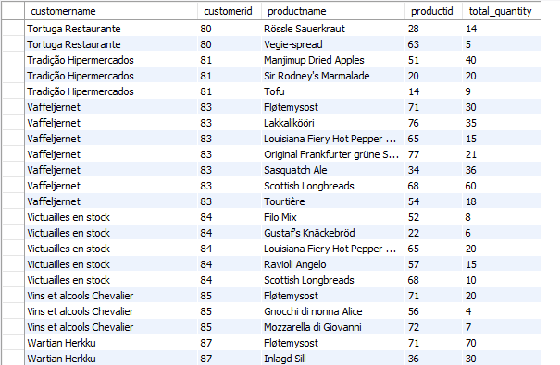
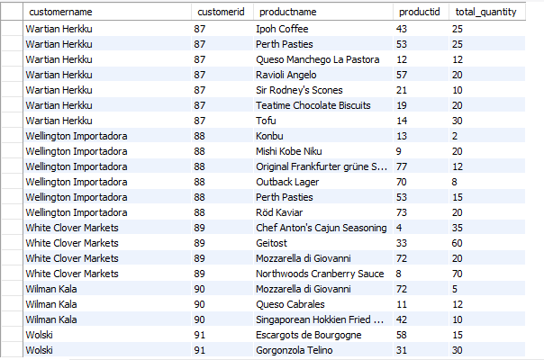
TWENTIETH PORTION OF RESULT
TWENTY-FIRST PORTION OF RESULT
TWENTY-SECOND PORTION OF RESULT

Slide 19
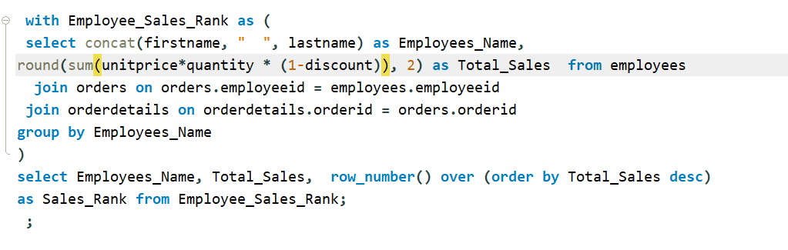
THIS IS A QUERY THAT Ranks employees based on their total sales. it Shows the employee name, total sales and their rank.
Q9
THE QUERY
THE RESULT
Employees_Name | Total_Sales | Sales_Rank
Margaret Peacock | 9165 | 1
Nancy Davolio | 4932.13 | 2
Janet Leverling | 4675.58 | 3
Andrew Fuller | 3489.09 | 4
Laura Callahan | 3448.23 | 5
Michael Suyama | 2902.49 | 6
Steven Buchanan | 2177.74 | 7
Anne Dodsworth | 2017.97 | 8
Robert King | 1966.56 | 9

Slide 20
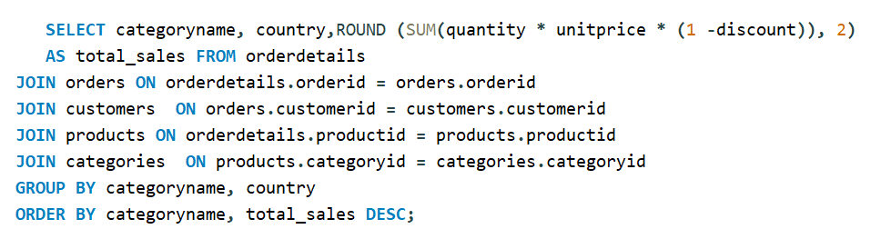
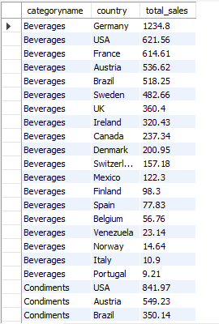
THIS IS A QUERY THAT displayS the total sales amount for each product category, grouped by country
Q10
FIRST PORTION OF RESULT
THE QUERY

Slide 21
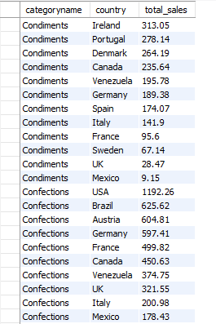
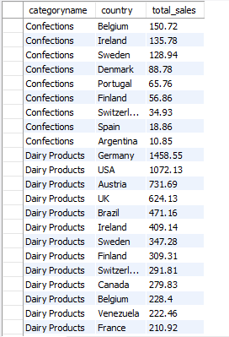
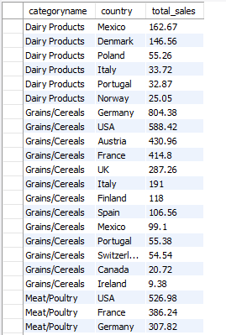
SECOND PORTION OF RESULT
THIRD PORTION OF RESULT
FOURTH PORTION OF RESULT

Slide 22
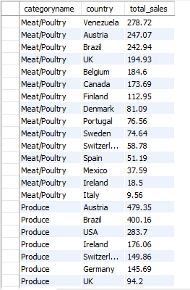
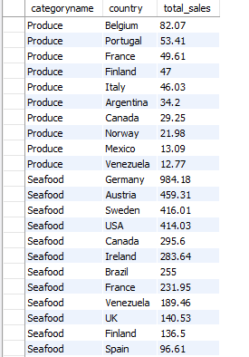
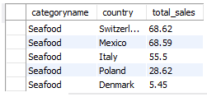
FIFTH PORTION OF RESULT
SIXTH PORTION OF RESULT
LAST PORTION OF RESULT

Slide 23
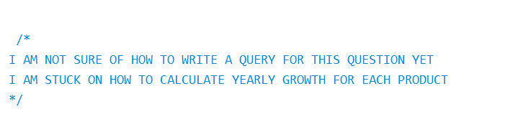
THIS IS A QUERY TO SHOW THE CalculatION OF the percentage growth in sales from one year to the next for each product
Q11

Slide 24
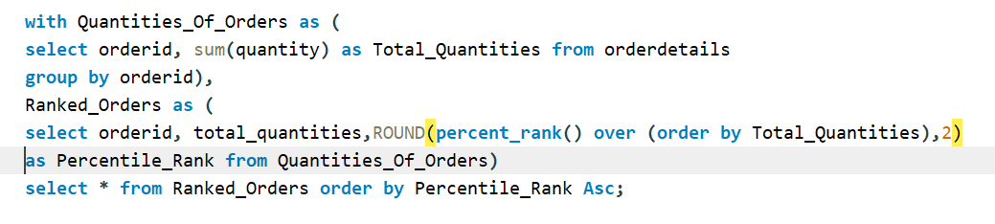
THIS IS A QUERY THAT SHOWS THE CalculatION OF the percentile rank of each order based on the total quantity of products in the order
Q12
FIRST PORTION OF RESULT
THE QUERY

Slide 25
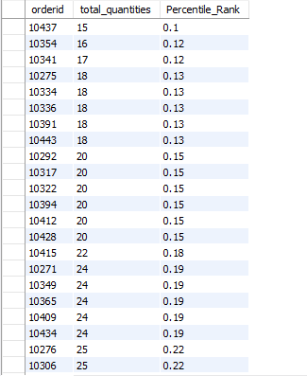
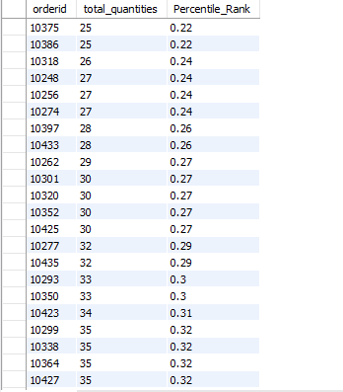
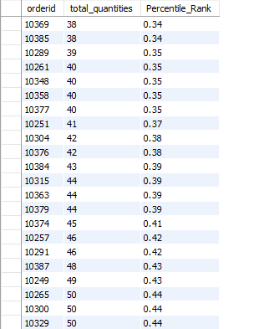
SECOND PORTION OF RESULT
THIRD PORTION OF RESULT
FOURTH PORTION OF RESULT

Slide 26
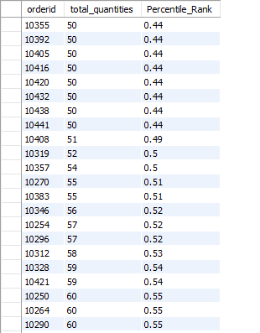
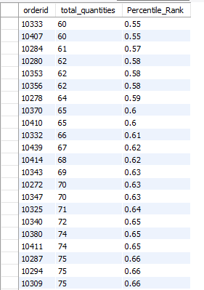

FIFTH PORTION OF RESULT
SIXTH PORTION OF RESULT
SEVENTH PORTION OF RESULT

Slide 27


EIGHTH PORTION OF RESULT
LAST PORTION OF RESULT

Slide 28

THIS IS A QUERY THAT Identifies the products that have been sold but have never been reordered (ordered only once).
Q13
THE QUERY
THE RESULT
productid | productname | orders
9 | Mishi Kobe Niku | 1
45 | Røgede sild | 1
48 | Chocolade | 1
67 | Laughing Lumberjack Lager | 1

Slide 29


THIS IS A QUERY THAT SHOWS the productS that has generated the most revenue in each category
Q14
FIRST PORTION OF RESULT
THE QUERY

Slide 30



SECOND PORTION OF RESULT
THIRD PORTION OF RESULT
LAST PORTION OF RESULT

Slide 31


THIS IS A QUERY THAT DISPLAYS THE orders where the total price of all items exceeds $100 and contains at least one product with a discount of 5% or more.
Q15
FIRST PORTION OF RESULT
THE QUERY

Slide 32


SECOND PORTION OF RESULT
LAST PORTION OF RESULT

